Slide 1
Getting a single-cell CC3D simulation
The easy way
Juliano F. Gianlupi

Slide 2
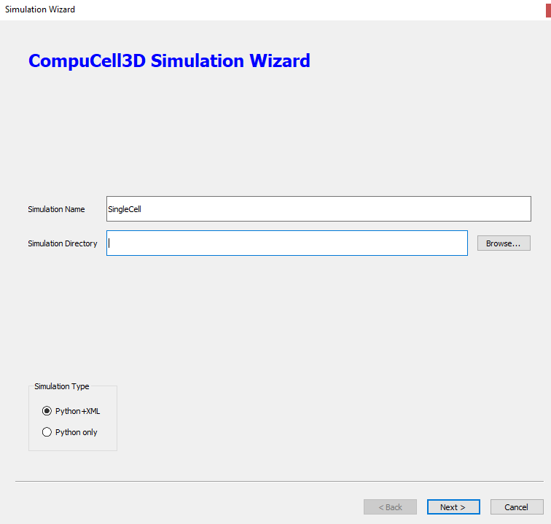
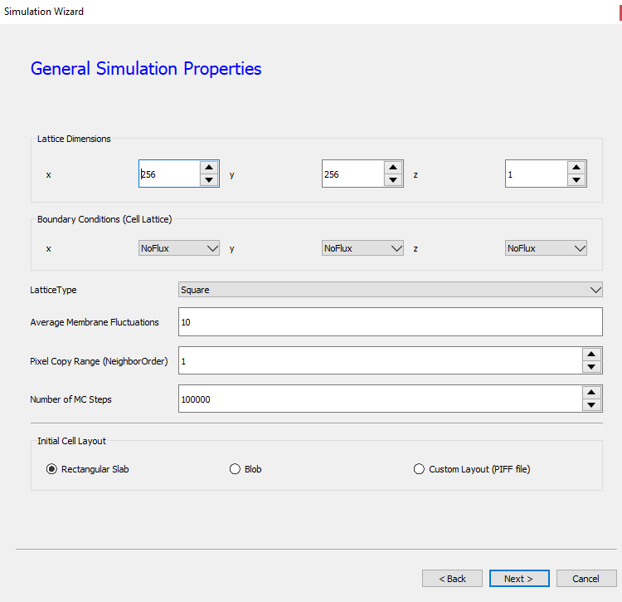
Step 1: start twedit++ sim wizard
Doesn’t mater, we’ll remove it

Slide 3
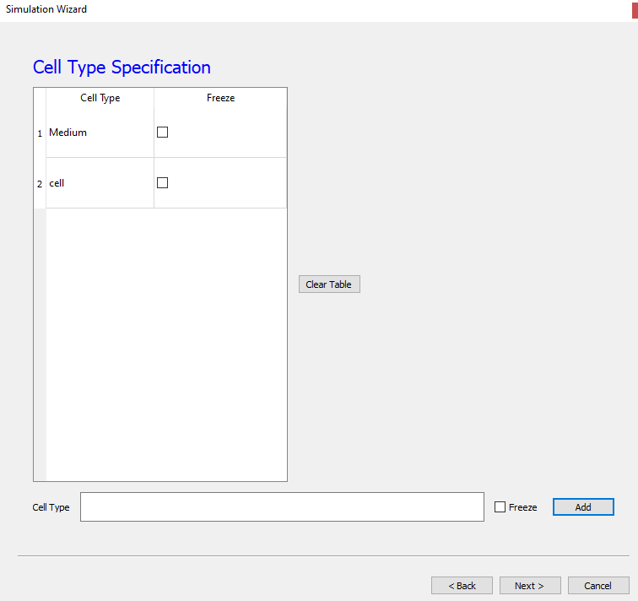
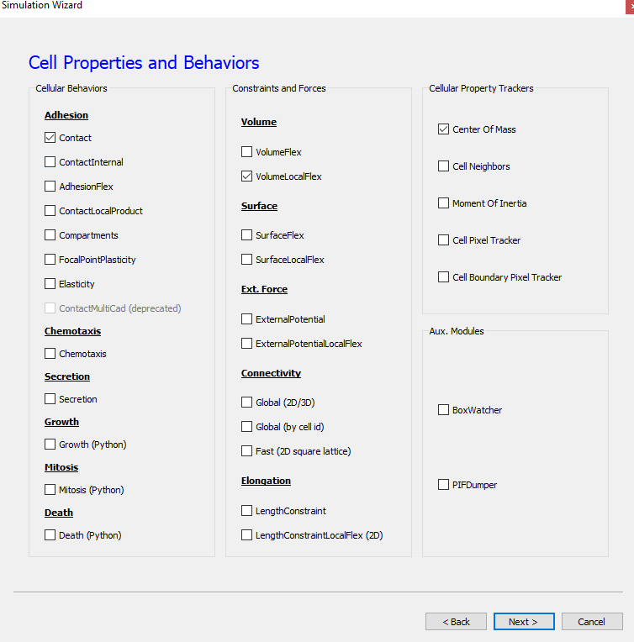
Step 2: add cell types, chemicals, and select plugins. Finish wizard

Slide 4
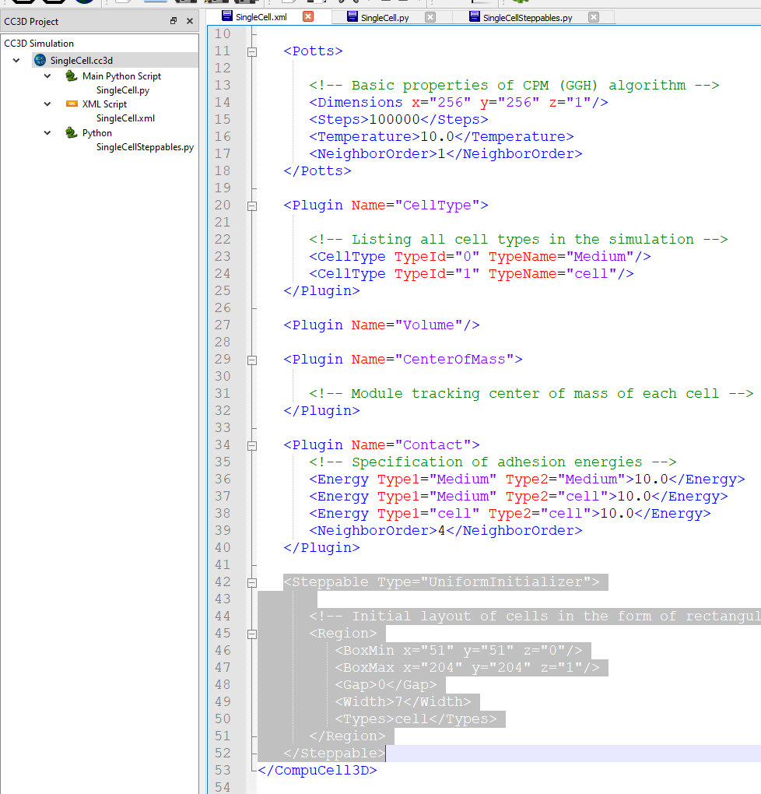
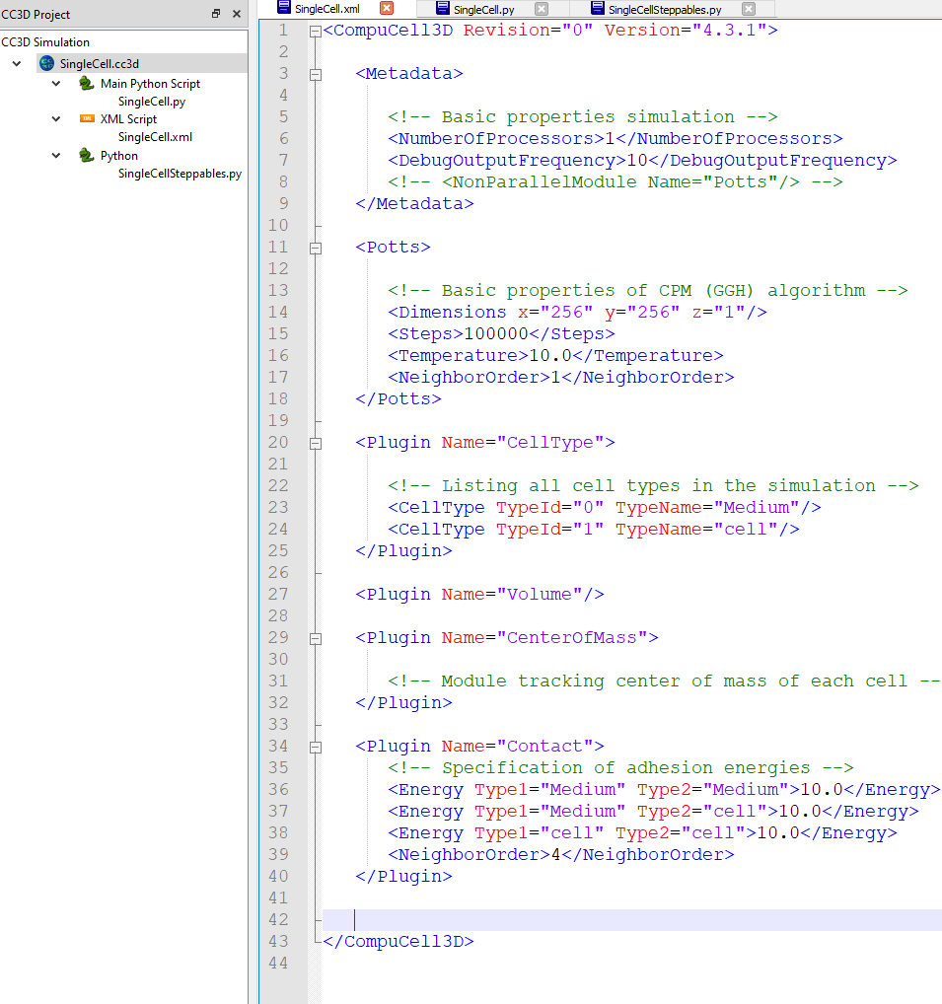
Step 3: remove initializer from XML

Slide 5
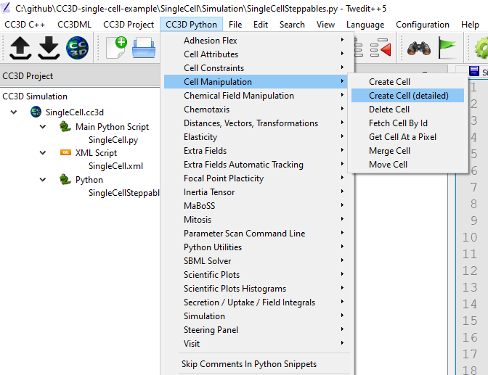
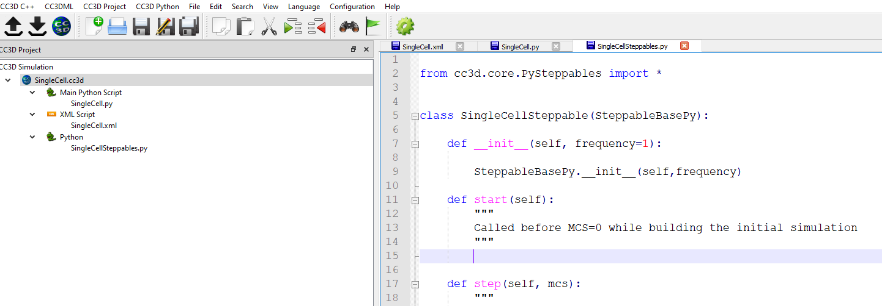
Step 4: Place cursor in start function, select Create Cell (detailed) in CC3D python menu
CC3D Python > Cell Manipulation > Create Cell (detailed)

Slide 6
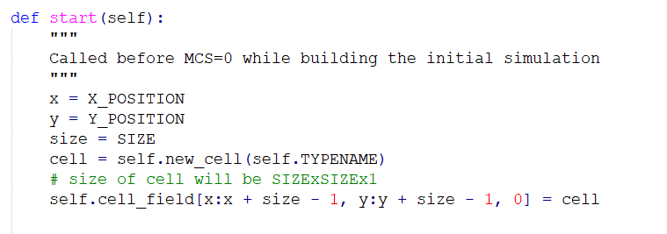
Step 4.2: See results

Slide 7
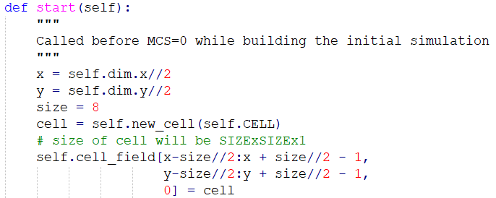
Step 5: Set position of cell, volume, type, etc
self.dim.x;y;z are steppable attributes with the maximum value for the axes
Double division slash (//) is division rounded down in Python
I prefer placing the cell from center – half the size to center + half the size
You can place the cell anywhere with any volume

Slide 8
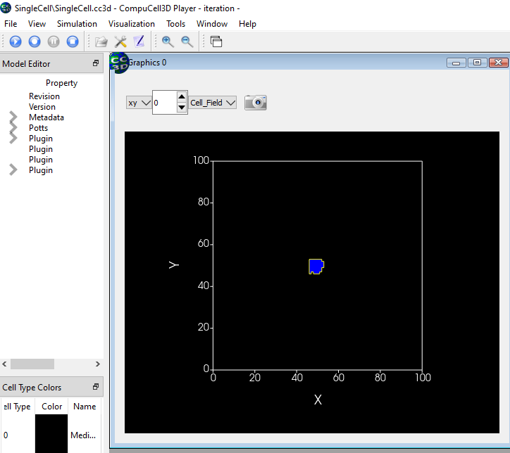
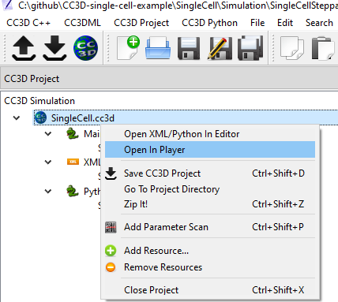
Step 6: Test (right-click .cc3d file -> Open In Player)

Slide 9
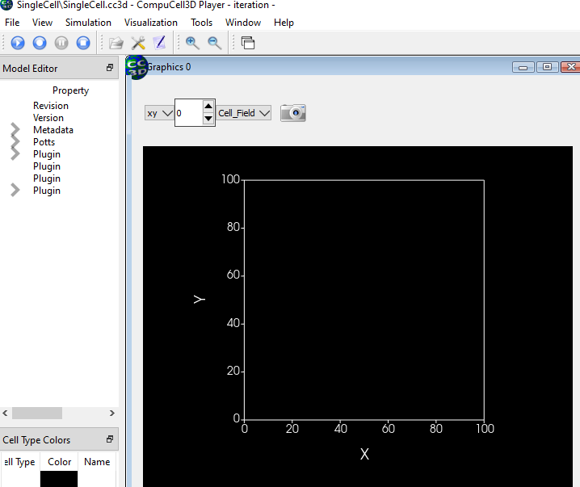

Step 7: realize your cell disappears because you forgot to set the target volume and $λ$ volume

Slide 10
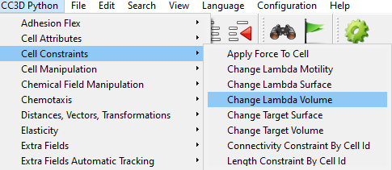
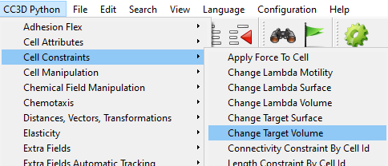
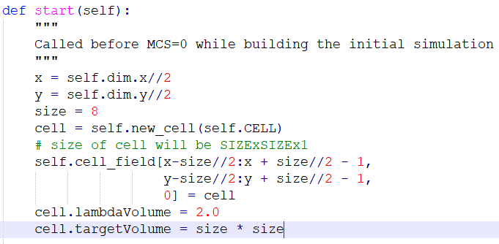


Step 8: set target and $λ$ volume
CC3D Python > Cell Constraints > Change $λ$ Volume
CC3D Python > Cell Constraints > Change Target Volume

Slide 11
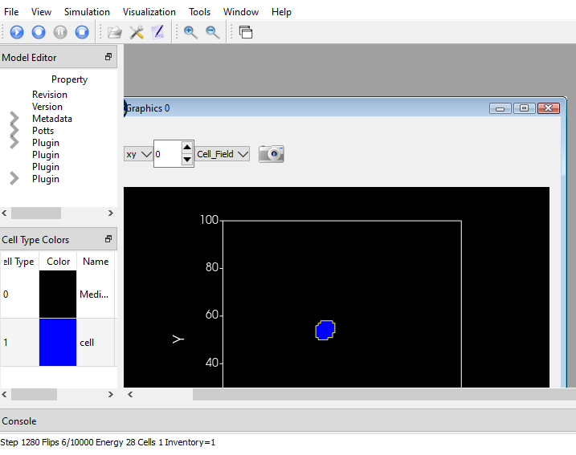
Step 9: check that your cell doesn’t disapear

Slide 12
DONE

